Slide 1

EchoMind: Intelligent Audio Transformation via Text Prompts
Presented By:
ABOUHANE Zahra, BAZGOUR Yassine
Supervised By:
Dr. Mohamed Amine Chadi
https://www.flaticon.com/search?word=data

Slide 2
Problematic
01

Slide 3
73%
of creators struggle with complex audio editing tools when trying to improve sound quality
(2024, Adobe Research)
https://blog.adobe.com/en/publish/2024/10/08/adobes-ai-creative-frontier-study-reveals-creators-views-opportunities-risks-generative-ai

Slide 4
OVER 70%
of audio editors believe AI-assisted tools still fail to accurately follow user instructions (2024, Audio Engineering Society)
https://menlovc.com/perspective/2025-the-state-of-consumer-ai/

Slide 5
8 IN 10
content creators say they waste hours manually editing audio instead of focusing on creativity (2024, Creative Workflow Survey)(2024, Adobe Research)
https://untechaihub.com/best-ai-tools-for-video-and-audio-content/

Slide 6
Aim
02

Slide 7

Intelligent Audio Editing through AI

Slide 8
Related Work
03

Slide 9
Text To Audio
AudioGen
Make-An-Audio
AudioLDM

Slide 10
Text & Audio To Audio
(not open source)
MusicGen
AudioBox
NVIDIA Fugatto
Stable Audio 2.0 (commercial)

Slide 11
System Architecture
04

Slide 12






Sound Effects Data
Edited Audio Data
Raw Audio Data
CSV File
BERT & U-NET
Prompts Data

Slide 13
Data
05

Slide 14

The ARCA23K dataset contains 23,727 audio clips covering 70 distinct sound-event classes. The clips are mono 16-bit WAV files sampled at 44.1 kHz, with durations ranging from a fraction of a second up to 30 seconds. The dataset includes training, validation, and test splits, and was created through automated collection from Freesound, resulting in some label noise and out-of-vocabulary sounds.
https://zenodo.org/records/5117901

Slide 15


Samples From The Dataset

Slide 16
23,727 audio clips 70 sound-event classes Audio Modality: Mono 16-bit WAV files, 44.1 kHz Variable duration: 0.3–30 seconds Labels automatically assigned from FreeSound metadata

Slide 17
Model
06

Slide 18
BERT
The text encoder is based on BERT, a Transformer-based language model that reads text in both directions, allowing it to understand full context instead of just left-to-right or right-to left dependencies. Its architecture is a stack of Transformer encoder blocks, each containing multi-head self-attention and feed-forward layers. The output is a contextual embedding that captures the semantic meaning of the prompt.

Slide 19
U-NET
The audio model is based on a 1D U-Net architecture adapted for raw waveform processing and conditioned on text information. The network follows the standard U-Net structure with an encoder, a bottleneck, and a decoder, but integrates cross-attention layers to fuse audio features with the BERT text embeddings.

Slide 20
U-NET
The encoder consists of multiple DownBlocks. Each DownBlock applies a convolution, two residual blocks, and an optional cross-attention module. When attention is enabled, the block performs audio–text fusion by allowing audio features to attend to the text embeddings. After processing, each DownBlock stores a skip connection and reduces temporal resolution through strided convolution.

Slide 21
U-NET
The bottleneck contains two residual blocks with a central cross-attention layer. At this stage, the audio representation is at its lowest resolution, and the attention mechanism injects the most global textual conditioning into the model.

Slide 22
U-NET
The decoder mirrors the encoder through a sequence of UpBlocks. Each UpBlock upsamples the feature map using a transposed convolution, aligns the temporal dimension with its corresponding skip connection, concatenates the features, and processes them through two residual blocks.

Slide 23
Interface
07

Slide 24



Audio
Preprocessing
Audio
Preprocessed
Audio
Raw
Audio
Edited
Audio
Editing
Prompt
User
Interface
Audio
Editing
Result
Prompt
Processed
Prompt
Text
Processing

Slide 25




Technologies Used
HTML
Javascript
CSS
Python
Backend
Frontend

Slide 26
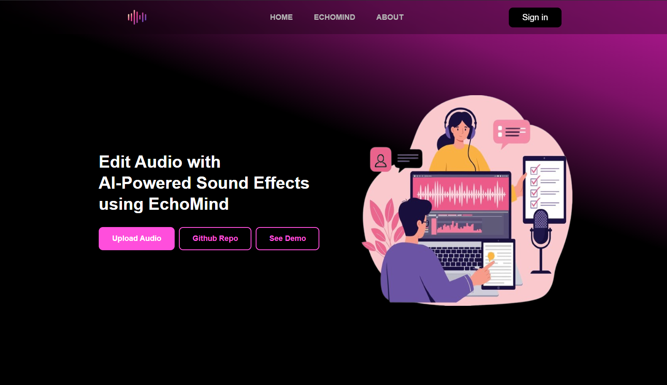

Slide 27
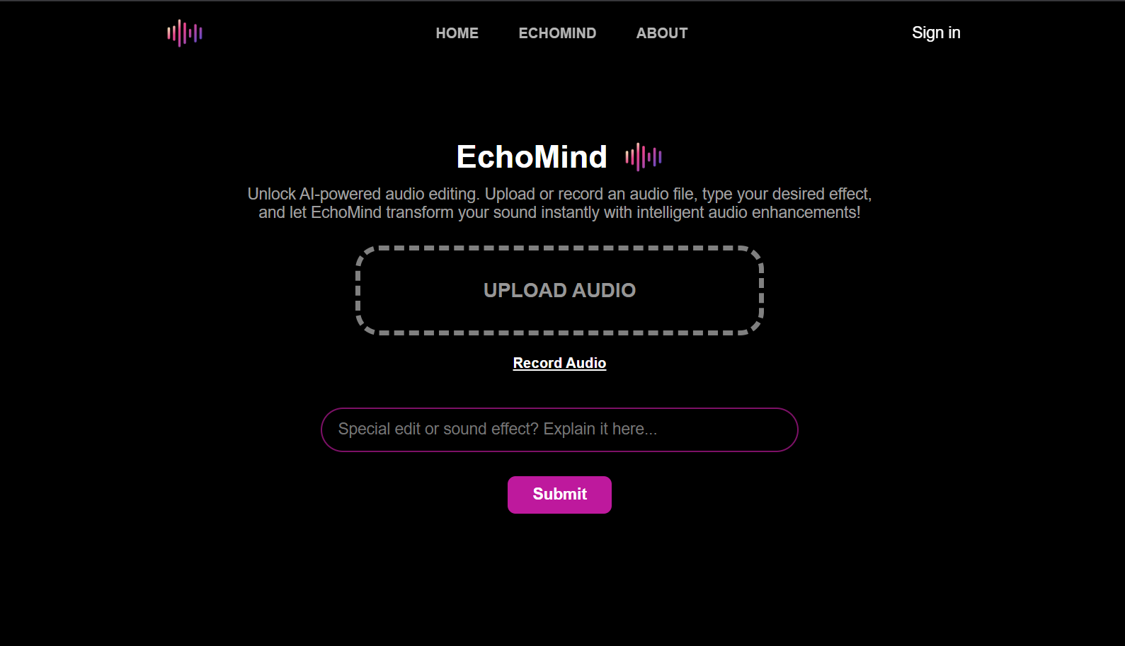

Slide 28
Results
08

Slide 29
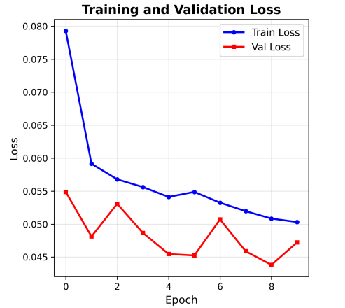

Slide 30
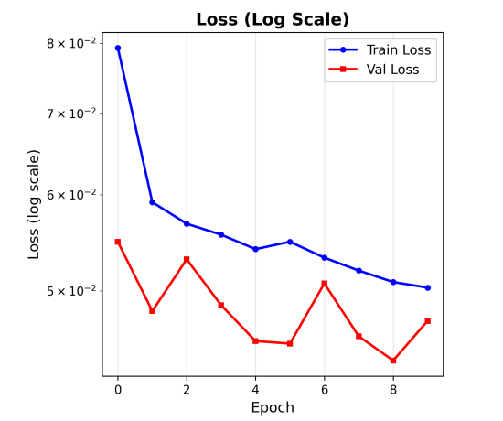

Slide 31
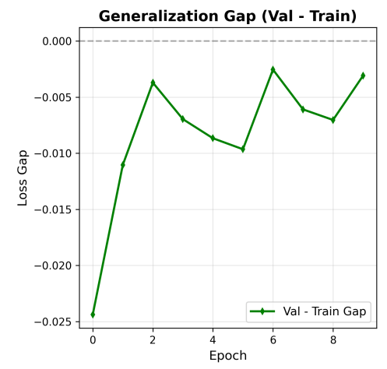

Slide 32
Discussion
09

Slide 33



Benefits
Content
Creation
Education and
Training
Media
Production

Slide 34


Limitations
Prompt understanding
Generalization
Limit

Slide 35
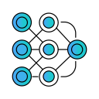

Future Work
Test Other Pretrained Models
Enlarge Dataset and Improve its Quality

Slide 36

Thank You

